Slide 1
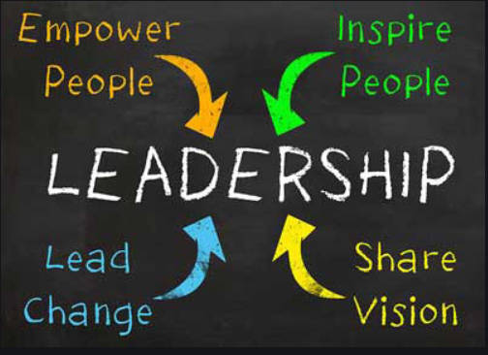
Medi Servattalab
INFO6255
Fall 2019
IT, Leadership and You
“It is a terrible thing to look over your shoulder when you are trying to lead and find no one there.”
-Franklin Delano Roosevelt

Slide 2

Is your team managed for success or survival?
Survival happens, success depends on effective leadership
What is management without leadership
  A missed opportunity...?
  Wishful thinking....?
  Risky business....?
  Or all of the above?

Slide 3
Leaders and Managers
The manager has his eye always on the bottom line.
The manager has a short-range view.
The manager administers.
The manager does things right.
The manager relies on control.
The leader has his eye on the horizon.
The leader has a long-range perspective.
The leader innovates.
The leader does the right thing.
The leader inspires trust.

Slide 4
Leadership characteristics in IT management
Process changers versus process followers:
  The manager follows the current development process to the letter and rarely questions it.
  The leader constantly questions the current development process and continually looks for ways to improve it.
Crossing boundaries:
  The manager believes that the division of labor, protocol, and formal communication are cornerstones to good organization and must be respected.
  The leader crosses functional boundaries and jurisdictions and deals directly with key people in other functional groups.
Notes:
It can be difficult for a project manager interested in leadership to easily identify with the leadership context of CEOs, VPs, quarterbacks, platoon commanders, or educators.
Crossing Boundaries; Project management is a continual process of negotiating for resources, making deals, and getting commitments from different function groups in an organization. .
The term "manager" has been employed to contrast with "leader", becoming a kind of "less than a leader". Not true. Not less than just different!
A "leader" is a project manager displaying relatively strong leadership attributes, and a "manager" is a project manager with weak or non-existent leadership abilities.

Slide 5
Leadership characteristics in IT management
" Fire in the belly":
  A leader displays a burning desire to succeed and a constant high energy level. The drive to hit goals is relentless and infects the entire team.
  A manager is more steady-state, applying adequate energy level to get the job done, but not at a level that inspires and motivates the team.

Slide 6
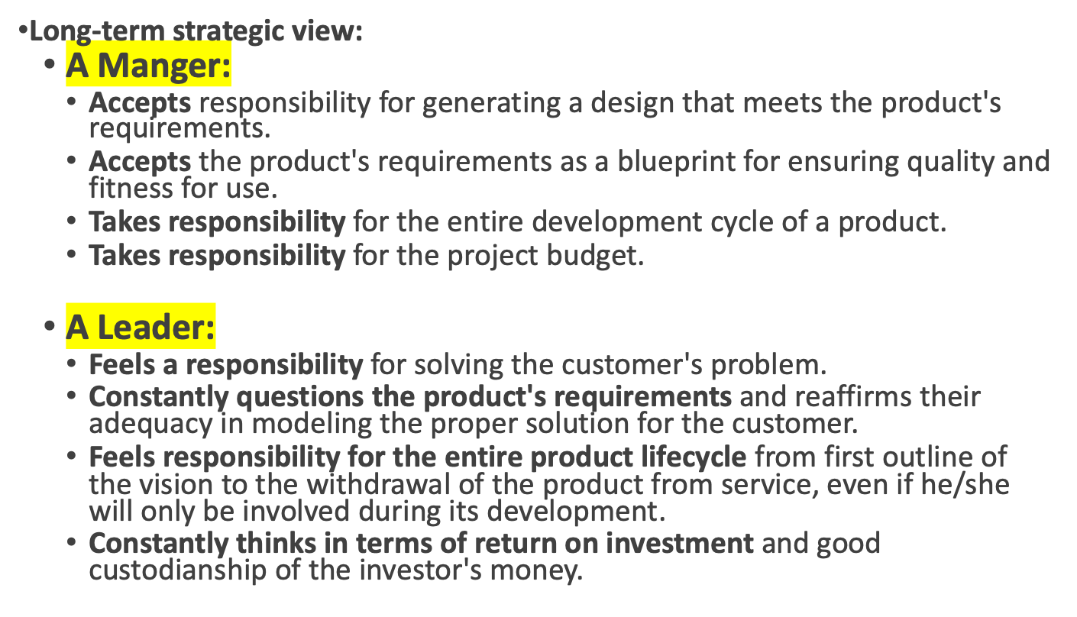
Leadership characteristics in IT management

Slide 7
Leadership characteristics in IT management
Accountability:
  A leader accepts responsibility for results both good and bad.
  A leader understands the inevitability of mistakes and the value of learning from them.
  A leader has enough faith in his/her abilities to transcend short-term (and shortsighted) dips in performance scores and evaluations.
Communication:
  A leader emphasizes personal contact, one-on-one's, and eyeball-to-eyeball commitments.
  A leader uses E-mail and voice mail as necessary but poor substitutes only when personal contact is not practical.
  Electronic foxholes are not part of a leader's arsenal.
Notes:
Project management tasks include reporting status, re-planning and midcourse corrections, and debriefing for lessons learned. In all of these activities, a manager is conscious of how negative revelations may affect his or her own near-term performance evaluations and "scores". We all keep score cards. Leaders focus on continual improvement and accept accountability, not focus on personal scores.

Slide 8
Lead by Example
As a team leader, your job is to lead, and to get the team to function as a cohesive unit. To meet this goal, you can follow a few simple steps centered around leadership by example....
  Avoid team domination ... your job is to lead, not to control.
  Uphold the ground rules.
  Ask open-ended questions to stimulate discussions.
  Be sensitive to contentious situations .... team conflicts are unavoidable, but at a team leader you can diffuse tense situations as needed with a few strategic words and actions.
Notes:
Avoid team domination ... your job is to lead, not to control. Even if you have all the answers, let the team dynamic play out.
Uphold the groundrules ... participation levels will rise when team members can see that all ideas are respected and given due consideration.
Ask open-ended questions to stimulate discussions.
Be sensitive to contentious situations .... team conflicts are unavoidable, but at a team leader you can diffuse tense situations as needed with a few strategic words and actions. For example, depending on the circumstances, you may choose to handle a conflict head-on, or you can table a difficult issue for a later time, when emotions have subsided. In any case, you should avoid isolated, off-side reactions to conflicts, and you should always be consistent in how you react to team conflict.

Slide 9
Summary
Team commitment and results depend on active participation
  The whole purpose of "teamwork" is to combine resources for better results.
  Ideas are contagious, and the more ideas, the better.
Team participation can alleviate these burdens, leading to high quality, creative solutions.
  As a Project Leader, you need to inspire and drive that participation
Leadership is not EASY
  If it was everyone would do it!
Notes:
Team commitment and results are dependent upon active participation
After all, the whole purpose of "teamwork" is to combine resources for better results (i.e. "two heads are better than one....").
Ideas are contagious, and the more ideas, the better, particularly in tough times, when budgets are tight, and resources are limited.
Team participation can alleviate these burdens, leading to high quality, creative solutions.
As the Project Leader, you need to inspire and drive that participation

Slide 10


The Positive vs Negative words
Disempowering Words
Empowering Words
Should
Need
Want
But
Can’t
Hard
Struggle
Have to
Problem
Issue
Try
Maybe
Coincidental
Accidental
By chance
I guess
I don’t care
Whatever
Choose
Will/Explore
Can
Could
Prefer/Desire
Want
Attract
Create
Select
And
Won’t
Stimulating
Discern
Opportunity
Not at this time
Aligned
Ides
Adapted from: Your Life as Art, Robert Fritz, Newfane Press, Vermont 2003
Notes:
Leaders choose the right words to motivate the individuals. Look at he disempowering words vs. Empowering words

Slide 11
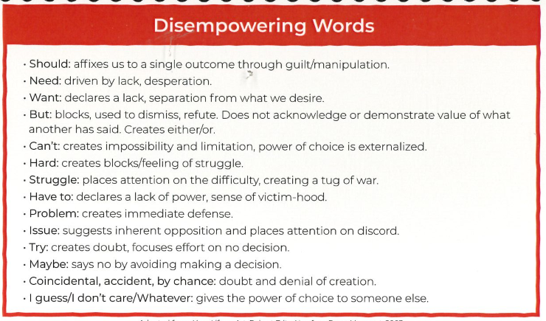
Adapted from: Your Life as Art, Robert Fritz, Newfane Press, Vermont 2003

Slide 12
16 Myers-Briggs Personality Types
The 16 personality test is generally based on the personality indicator developed by Katharine Cook Briggs and her daughter Isabel Briggs Myers. Their development of the test occurred in the 1940s and was built upon psychological research performed by Carl Jung in the 1920s.
ISTJ - The Inspector
ISTP - The Crafter
ISFJ - The Protector
ISFP - The Artist
INFJ - The Advocate
INFP - The Mediator
INTJ - The Architect
INTP - The Thinker
ESTP - The Persuader
ESTJ - The Director
ESFP - The Performer
ESFJ - The Caregiver
ENFP - The Champion
ENFJ - The Giver
ENTP - The Debater
ENTJ - The Commander

Slide 13
Myers-Briggs - Type and Your Work
When you understand your type preferences, you can approach your own work in a manner that best suits your style, including:
How you manage your time, problem solving, best approaches for decision making, and dealing with stress.
Knowledge of type can help you better understand the culture of the place you work, develop new skills, understand your participation in teams, and cope with change in the workplace.
https://www.myersbriggs.org/type-use-for-everyday-life/mbti-type-at-work/

Slide 14
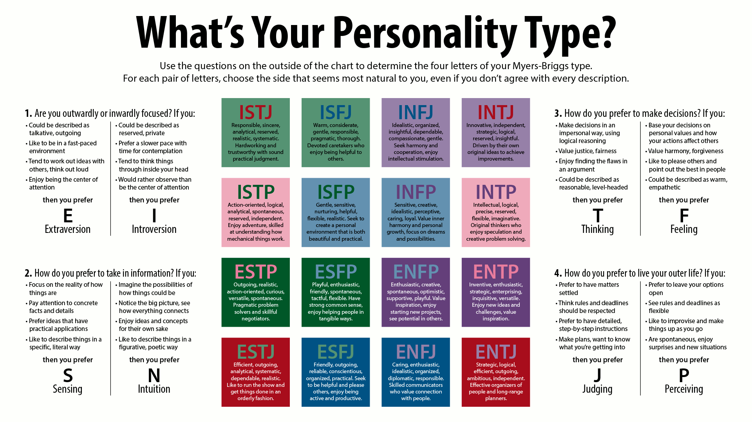

Slide 15
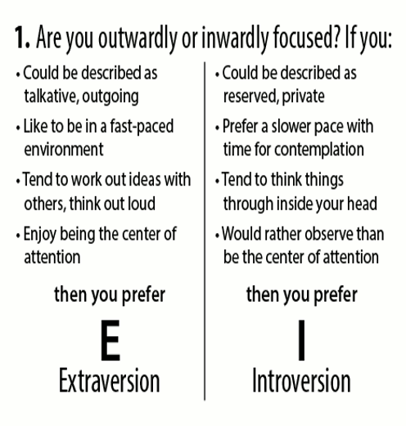
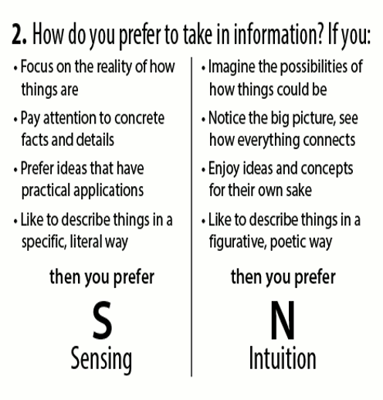
Personality Types

Slide 16
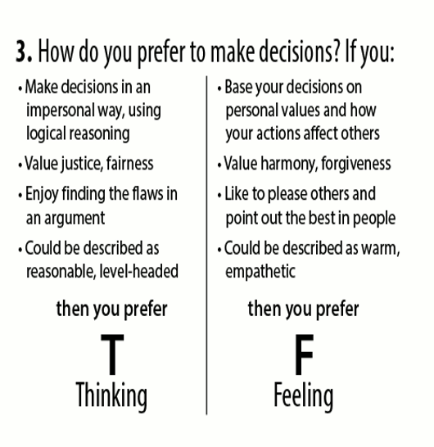
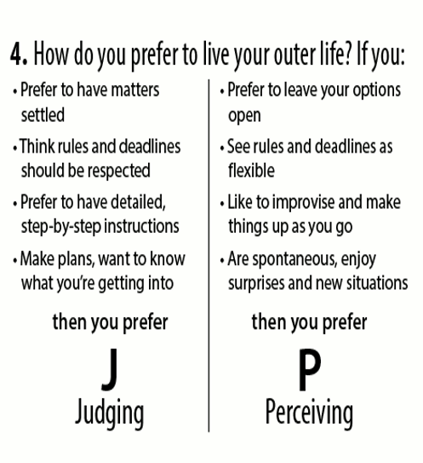
Personality Types

Slide 17
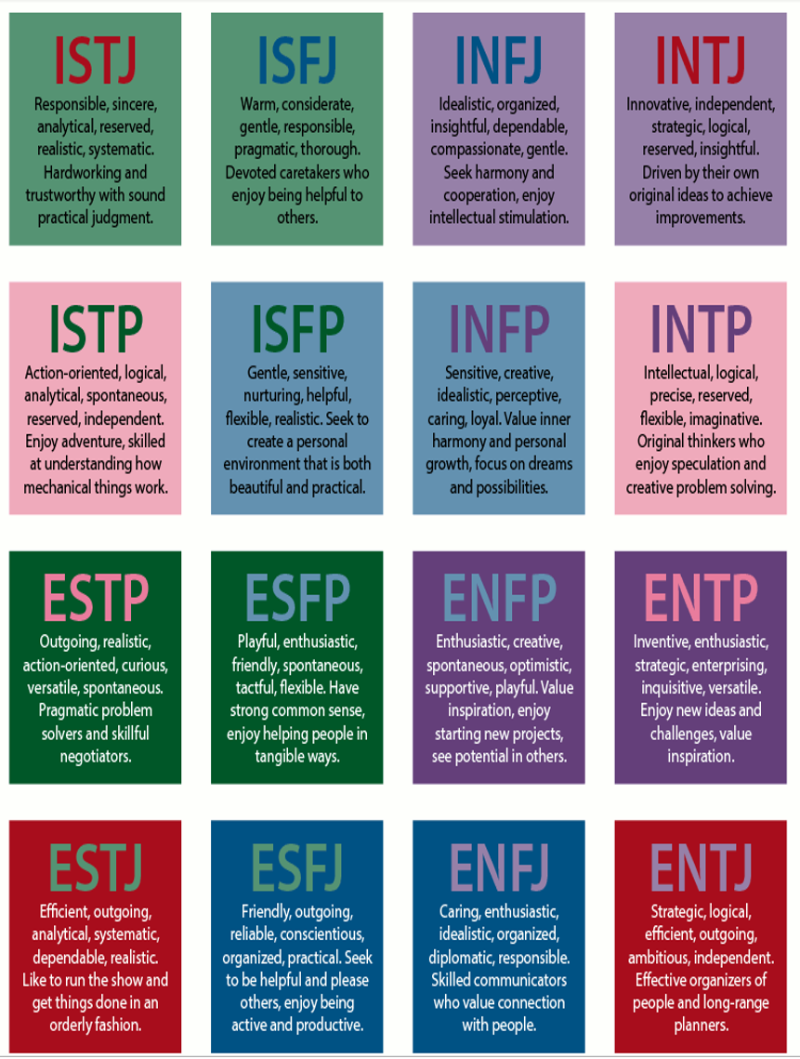
Personality Types (Myers Briggs)
ISTJ - The Inspector
ISTP - The Crafter
ISFJ - The Protector
ISFP - The Artist
INFJ - The Advocate
INFP - The Mediator
INTJ - The Architect
INTP - The Thinker
ESTP - The Persuader
ESTJ - The Director
ESFP - The Performer
ESFJ - The Caregiver
ENFP - The Champion
ENFJ - The Giver
ENTP - The Debater
ENTJ - The Commander

Slide 18
References
Leadership With Robert Fritz
  https://vimeo.com/90029158
https://www.verywellmind.com/the-myers-briggs-type-indicator-2795583
https://www.personalityperfect.com/16-personalities-test/
https://www.myersbriggs.org/type-use-for-everyday-life/mbti-type-at-work/

